Slide 1

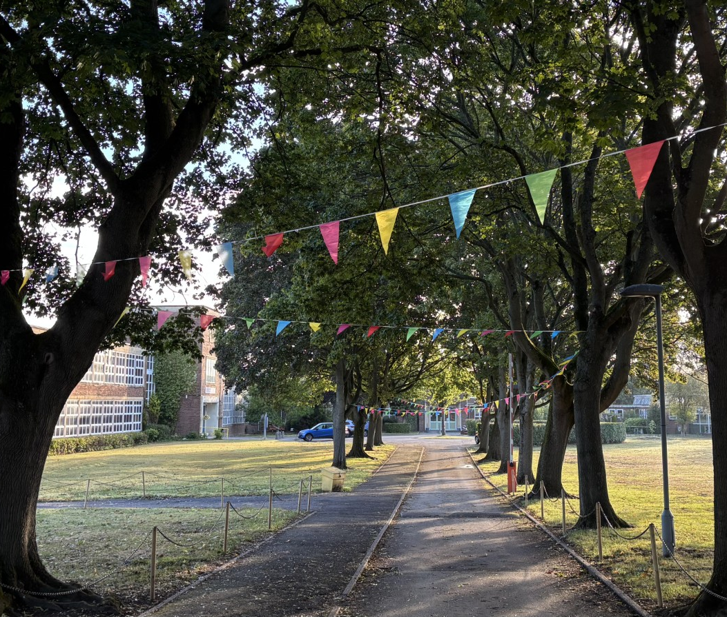
Welcome to
Mapledene Primary School
Information for new starters:
Reception 2026

Slide 2
About this evening​
Introduction from the Head Teacher: Mr Hyde​
The induction process for Reception: Mrs Mason
All about our Reception: Mrs Mason
Visit to Reception classrooms
and speak to school staff
Safeguarding: Mr Hyde
Inclusion and Early Help: Miss Johnson
Attendance: Miss Faulkner
School Uniform: Miss Faulkner

Slide 3
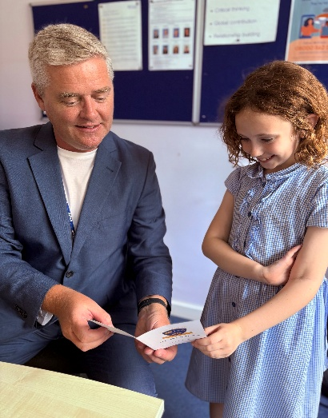
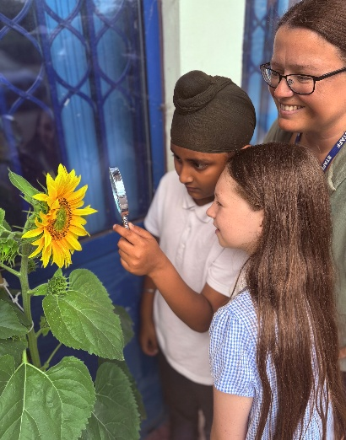
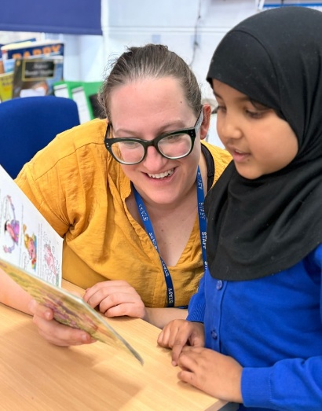
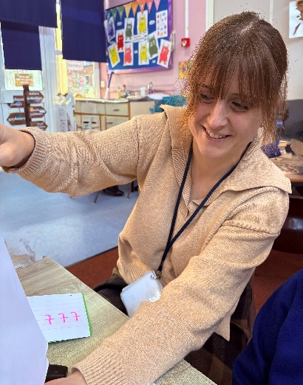
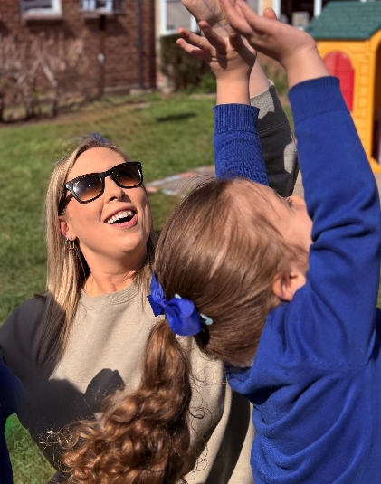
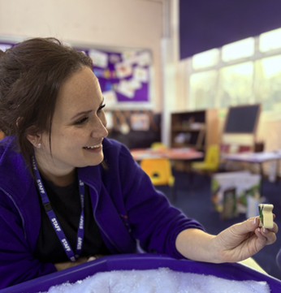
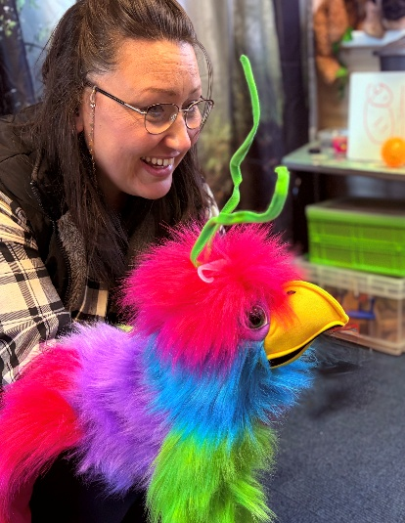
Meet the staff
Mr Hyde Headteacher
Miss Faulkner Assistant Headteacher
Miss Johnson
Assistant Headteacher
and SENDCo
Mrs Mason
EYFS Lead and Class Teacher
Mrs Walsh
Class Teacher
Miss Young
Class Teacher
Mrs Titchen
Speech & Language

Slide 4

Designated Safeguarding Lead (DSL)
Follow up on safeguarding concerns raised by:
Children
Teachers
Parents
Other adults or agencies
Act upon on safeguarding concerns by working in partnership with:
Children’s Services
Allocated Family Support or Social Workers
Police
Other agencies
Support families either directly or in partnership with other agencies to ensure positive outcomes for our children and their families.
At Mapledene we are very fortunate to have several Deputy DSLs, Miss Faulkner, Miss Johnson, Mrs Mason and Mrs Milnes, who support in our safeguarding provision.

Slide 5

Special Educational Needs at Mapledene
My name is Miss Johnson and I am the SENDCo at Mapledene.​
​
I work with teaching staff and staff from outside agencies to offer the best support to children and their family if they have an additional need. ​
​
This may include needs like speech and language or neurodiverse needs like autism or ADHD. ​
​
Please come and speak to me if you have any concerns regarding your child having an additional need. ​
​

Slide 6

Early Help at Mapledene
I am also the Early Help Lead at Mapledene.​
My role is to offer any advice, support and guidance with issues that are not classroom based. I am here to support our families, as a whole, when help is first needed. ​
​
Things that I can help with:​
-Parenting courses to support with behaviour and other issues​
-Accessing food banks​
-Second hand uniform​
-Informal chats and advice about wider issues including housing.

Slide 7
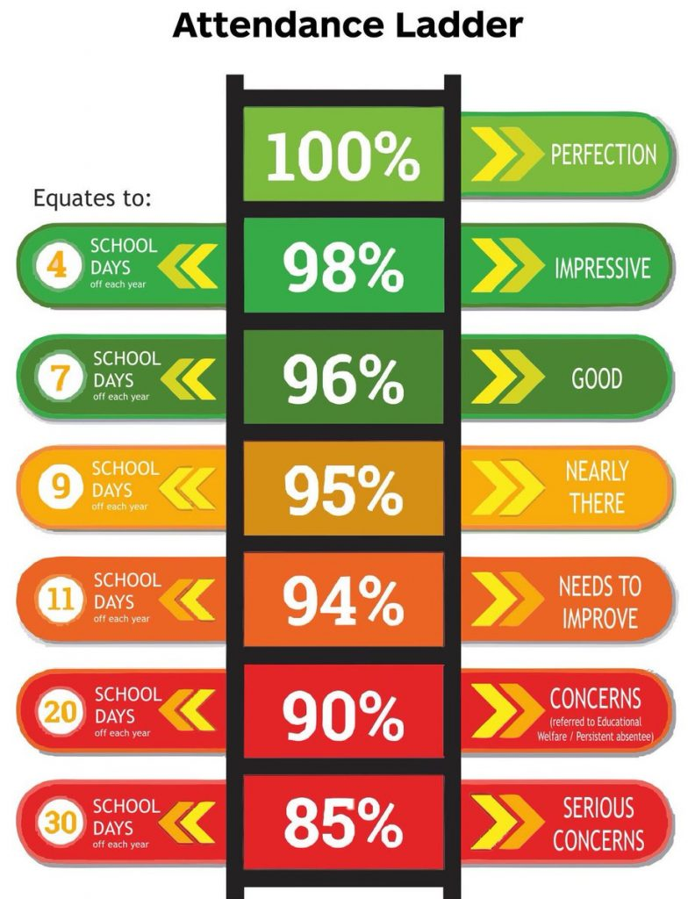
Attendance at Mapledene
Why is it important for your child to attend reception every day?
  Access all learning that is on offer to build blocks ready for the next steps in their learning.
  Build strong relationships with the adults and children in their class.
  Become used to school routines so that they can become more independent and ready for the next steps in their education.
As a school, we understand that at times children may need to be off school due to poor health.
There is strong evidence to suggest that children who attend school regularly in Primary School have better outcomes as adults.

Slide 8
The Induction Process​
We want your child to settle in confidently at Mapledene, which is why we have a fun and well-planned transition into Reception.
Monday 1st June – Teddy Bear’s Picnic Bring a teddy!
3:30pm–4:30pm – Drop-in play and stay session (parents to attend)
Wednesday 3rd June – Induction Meeting for Parents
5:00pm start
Monday 15th June – Snuggly Storytime Bring a favourite blanket or teddy
3:30pm–4:30pm – Drop-in play and stay session, ending with a cosy story (parents to attend)
Monday 29th June – Fancy Dress Fun Wear your favourite dressing-up costume
3:30pm–4:30pm – Drop-in play and stay session, ending with party songs (parents to attend)
Wednesday 1st July – Transition Morning: Stay and Play
9:30am–11:45am- children only
Please could children bring a packed lunch, as they will be practising eating in the school hall.
Thursday 2nd and Friday 3rd July – Home Visits
We will bring some ‘Ready Confetti’ and a special book to help with transition in September. Days and times are in your pack.
Please bring your child’s birth certificate into the office to be photocopied. Thank you.

Slide 9

Reception start date for September
All children will be starting Reception on Thursday 3rd September. Your child will have a start time, which you will find in your pack.
If we feel your child is finding it difficult to settle, then we will discuss this with you. We will always work with you in your child’s best interest.
We will let you know your child’s class and teacher once the children have settled and formed friendships.

Slide 10
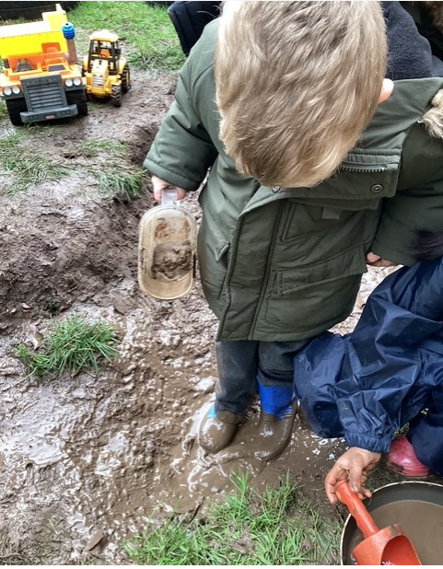
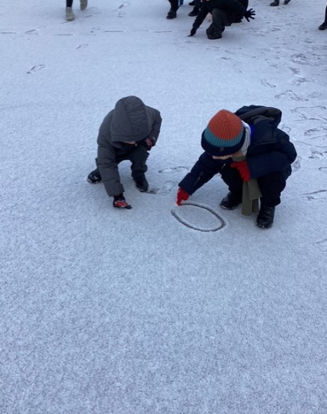
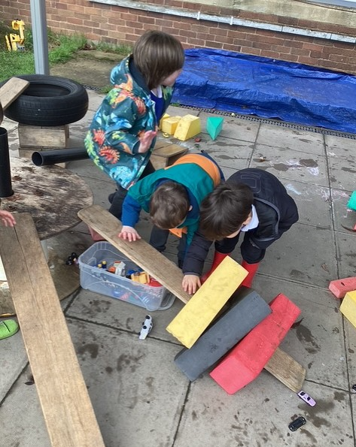
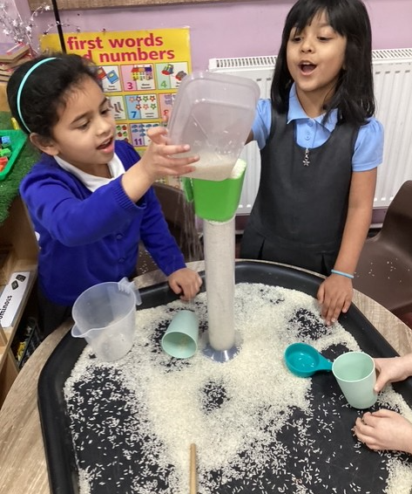
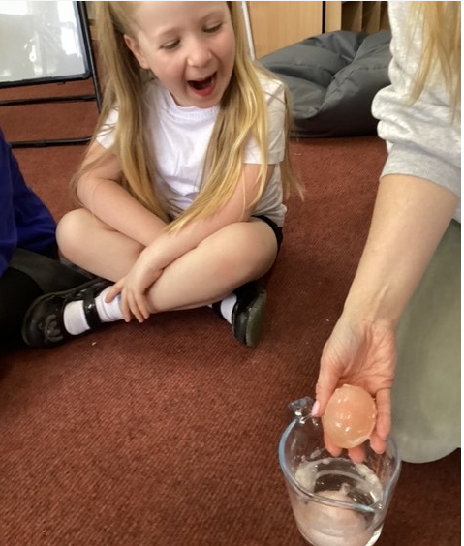
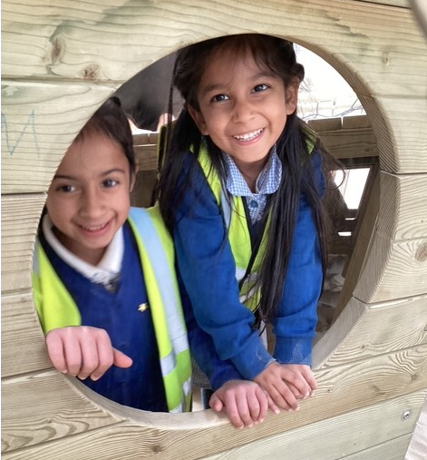
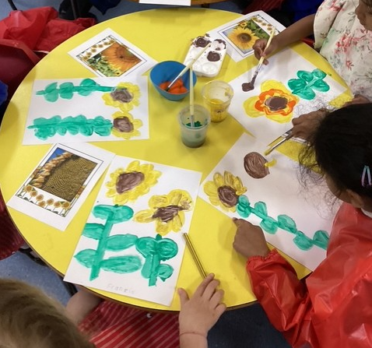
All About Reception
Children have their own entrance into Reception. It is a secure entrance where staff will greet the children every morning. Children are also collected from here at home time. Our school drop off is between 8.30am-9am and Reception finish at 3.20pm.
In Reception we continue to work within the early years foundation stage (EYFS) curriculum.
Staff will ensure that children work from where your child is at in their development using transition information from their previous settings and our baseline.
Children continue to work through the EYFS curriculum until the end of their Reception year, where they are expected to reach a good level of development (GLD).

Slide 11
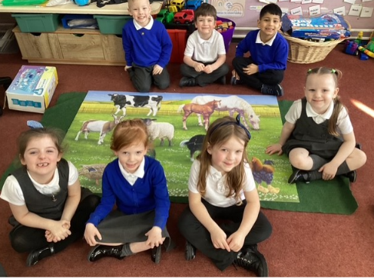
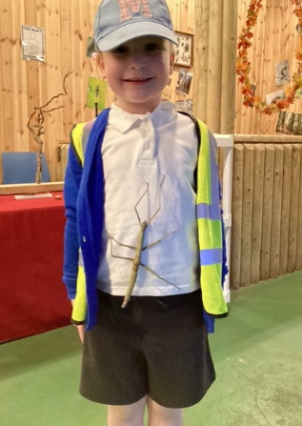
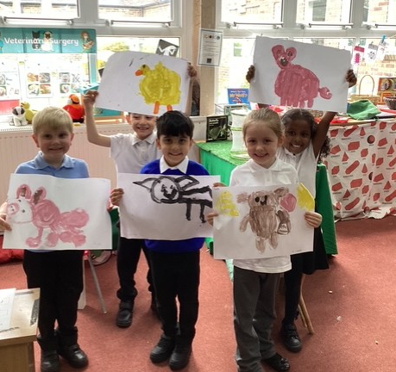
EYFS Framework
There are seven areas of learning and development, all of which are important and inter-connected. Three areas are particularly crucial for igniting children’s curiosity and enthusiasm for learning, and for building their capacity to learn, form relationships and thrive. These three areas, the prime areas, are:
• communication and language
• physical development
• personal, social and emotional development
The three prime areas are strengthened and applied through the specific areas of:
• literacy
• mathematics
• understanding the world
• expressive arts and design

Slide 12
Parental Involvement
Building a strong partnership between school and parents is at the heart of every child’s success. When we work together, children feel secure, supported, and confident as they begin their learning journey with us. We value open and regular communication so that we can share achievements, discuss progress, support any individual needs and for those daily check ins! By working in partnership, both at home and at school, we can ensure that your child is given the best possible start and encouraged to reach their full potential. We look forward to meeting you at our home visits and then inviting you to into school to work with us for our school trips, nativity, mystery readers, workshops, (step into early years and phonics) and our Very Hungry Caterpillar tea party.
Autumn 1 | Autumn 2 | Spring 1 | Spring 2 | Summer 1 | Summer 2
This is me! (workshops) | Hello Autumn (Nativity) | Once Upon a Time (mystery reader) | Down on the farm (trip) | Ready, Steady Grow! (tea party) | Come fly with me (trip)

Slide 13
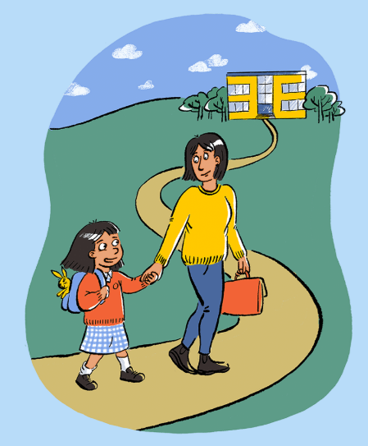
School Readiness
Your child's journey to school starts at home
Skills to practise before starting Reception:
Growing independence
Building relationships and communicating
Physical development
Healthy routines
Further information can be found on our school website by going on the EYFS page and following the link.

Slide 14
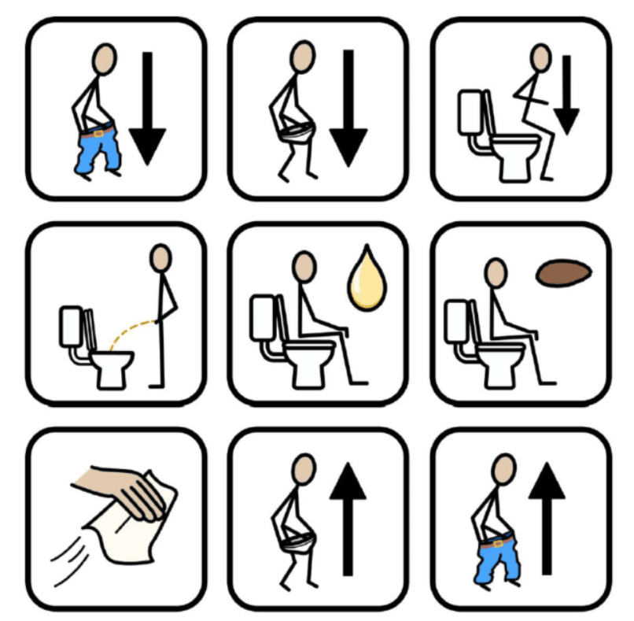
Encouraging Independence
Please ensure that your child is toilet trained before starting in Reception. If your child has a specific need that affects their toileting; please speak to a member of staff this evening.
If your child isn’t currently toilet trained or you need extra support regarding a toileting issue, then please visit the following website which is designed to offer support to parents.
Potty training - ERIC

Slide 15
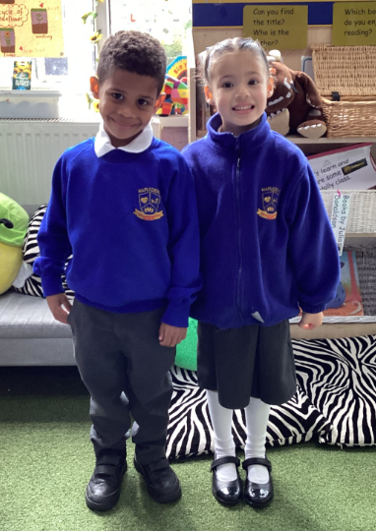
School uniform
Children will need to wear:
either a royal blue jumper or cardigan
white polo under cardigan
grey trousers, skirt or pinafore dress
black school shoes. No laces please.
In the Summer, children may wear the school Summer dress or grey shorts.
In the Winter, children may wear the school fleece.

Slide 16
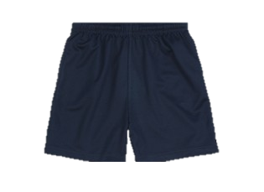
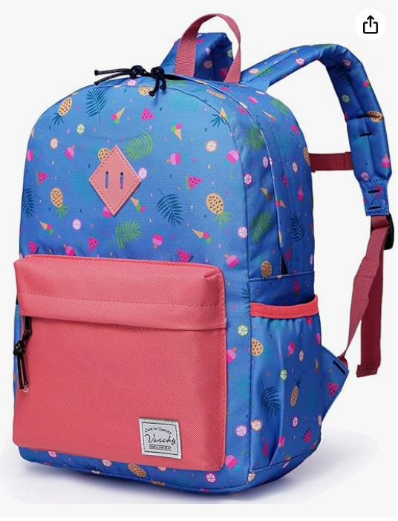


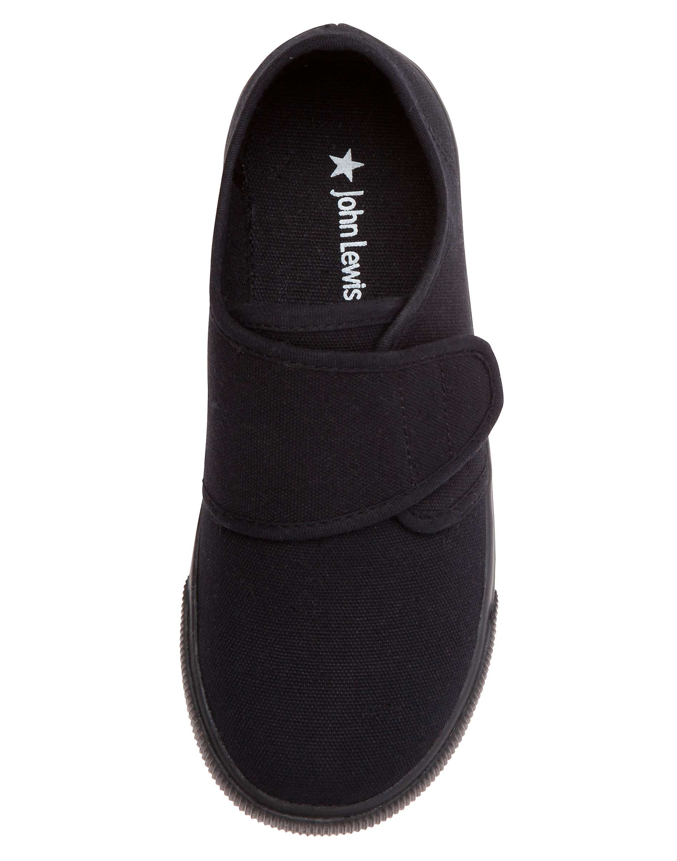

Please can all school uniform and PE kits be clearly labelled with your child’s name.
PE KIT
Children will need a white top, navy blue shorts or joggers and black Velcro pumps.

Slide 17

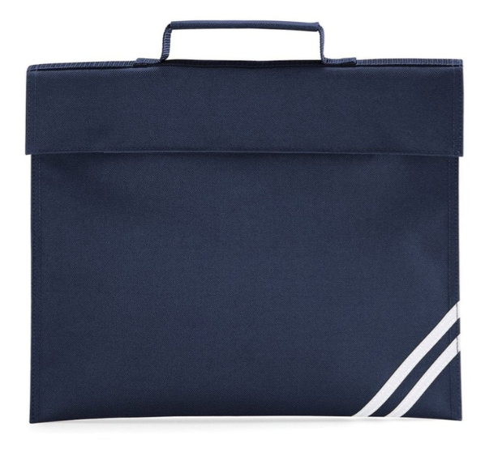
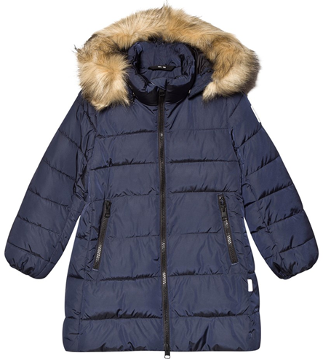
Your child must bring in a water bottle everyday please, with their name clearly visible and a school bag for books.
Please send your child to school in suitable outdoor clothing.
E.g. a suitable coat is needed every day and sunhats when sunny.

Slide 18
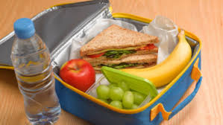
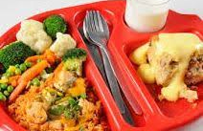
Dinner Time
All children in Reception are entitled to a
free school meal or, if you prefer, they can bring in
a packed lunch.
Schools receive extra funding for children whose parents are in receipt of certain benefits. This funding is vital to our school.
If you believe that this applies to you, please check at:
https://www.cloudforedu.org.uk/ofsm/mapledene
even if you wish for your child to have a packed lunch.

Slide 19
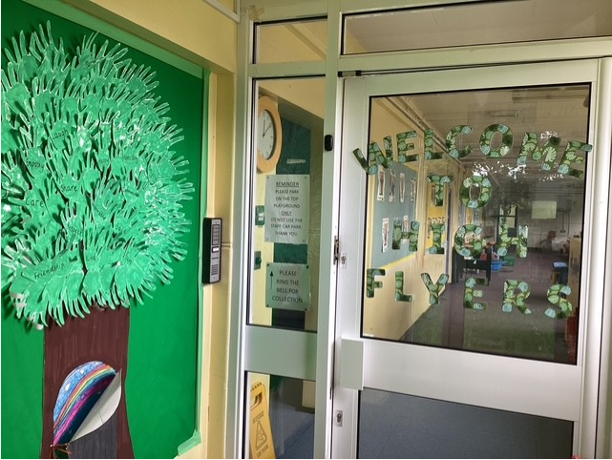
Wraparound care
We offer daily before and after school provision to all year groups.
Children can be dropped off in the morning anytime from 7.45am onwards. A morning session costs £6.00
After school provision begins at the end of the school day and the last pick-up time is 5.30pm.
An afternoon session costs £6.50 until 4.30pm and £9.00 until 5.30pm.

Slide 20
Thank you for coming this evening.​
​
We look forward to starting your child’s learning journey throughout Mapledene Primary School.
​
Please feel welcome to ask any questions. Thank you.​

